Slide 1
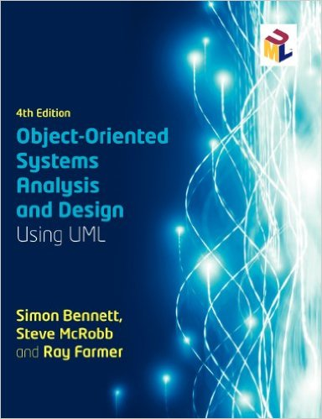
ITOO311
TEXTBOOK
Chapter 15
WEEK 10

Slide 2
15.1 Introduction
Design patterns help to capture knowledge about problems and successful solutions in systems design.
Systems analyst applies potential solutions to development problems.

Slide 3
15.2 Software Development Patterns
15.2.1 Frameworks
Help with reuse
Reusable mini-architecture for all applications
Framework can employ several patterns
Patterns are more abstract (not itself a solution)

Slide 4
15.2.2 Pattern catalogues and languages
Catalogue – group of related patterns (use together or alone)
Language – more closely related (work together to solve problems)

Slide 5
15.2.3 Software development principles and patterns
Patterns based on sound software development principles:
        Abstraction
        Encapsulation
        Information hiding
        Modularisation
        Coupling and cohesion
        Etc.

Slide 6
15.2.4 Patterns and NF requirements
Patterns address issues raised by NF requirements
(reusability, reliability, etc.)

Slide 7
15.3.1 Template contents (document patterns)
Pattern description elements:
Name (reflecting knowledge)
Problem (that pattern addresses)
Context (circumstances under which occur)
Forces (constraints or issues solution must address)
Solution (pattern parts relationships; should resolve all forces)

Slide 8
15.3.2 Other aspects of templates
Templates could have more detail:
Example of pattern application
Rationale justifying solution
Related patterns
Aliases for the pattern (AKA-also known as)
Etc.

Slide 9
15.4.1 Types of design pattern
23 design patterns by four authors (Gang of Four – GOF patterns)
Creational; Structural; Behavioural
Reduce coupling (dependency) and maximise cohesion (single function)
Patterns use inheritance and composition for desired result

Slide 10
15.4.1 Types of design pattern
Changeability aspects:
Maintainability: correct errors
Extensibility: New features; improved versions
Restructuring: reorganise components to increase flexibility
Portability: IS can execute on other OS or different hardware

